Slide 1
Machine Learning Intuitively
Day of Learning 20th Dec 2019

Slide 2

a learner’s perspective

Slide 3

You could expect
Establish scenario
Core tenets
Data observation
Fine tuning
Self-learning framework
& Basic use of math

Slide 4

You shouldn’t expect
Anything about tooling
Anything Azure has to offer
Data visualization techniques
Laundry list of algorithms
Neural Network/Deep Learning

Slide 5

Machine Learning Cliché
Data
Outcome
Traditional
Rules
Data
Rules
ML
Outcome

Slide 6

Context
Find groups of failures associated to common root cause
Group failures that look similar

Slide 7

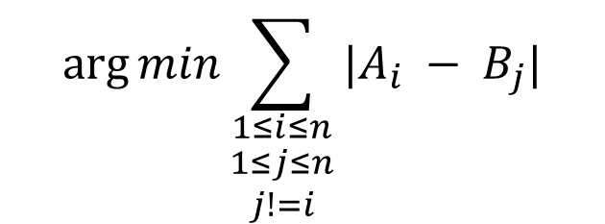
State the Objective Objectively
Can we express this as an objective instruction for a machine?
Could it be?
$$\arg{min}\sum_{\begin{aligned}1≤i≤n \\ 1≤j≤n \\ j!=i\end{aligned}}{|A_{i} − B_{j}|}$$

Slide 8

Terminology
Mean
Mode
Variance
Data
Parameter
Distribution
Dimension
Latent Variable
Covariance
Model
Hyper Parameter
Correlation
Objective Function
Similarity
Distance

Slide 9
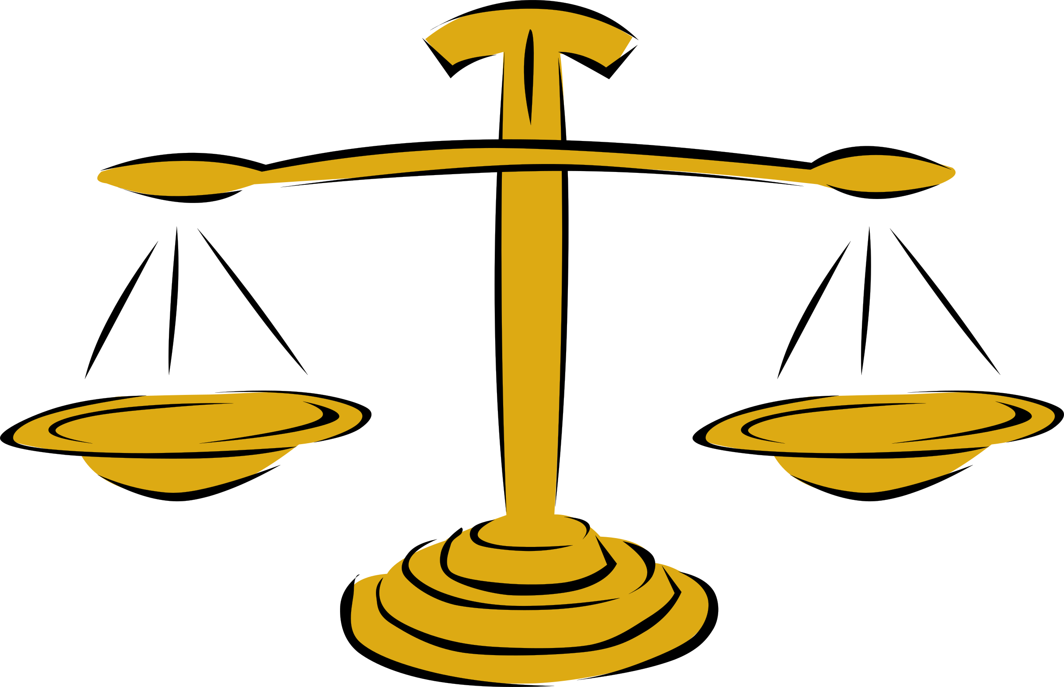
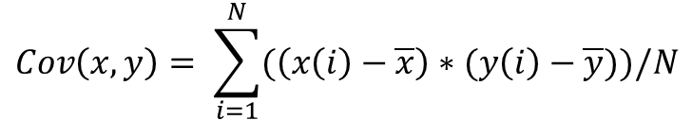
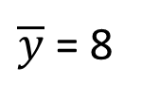
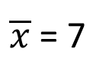


Covariance
14
$$x=\left[1, 3, 5, 7, 9, 11, 13\right]$$
8
$$y=\left[2, 4, 6, 8, 10, 12, 14\right]$$
$\overline{x}$ = 7
2
$\overline{y}$ = 8
1
7
13
$$Cov\left(x,y\right)= \sum_{i=1}^{N}{(\left(x\left(i\right)−\overline{x}\right)∗(y\left(i\right)−\overline{y}))/N}$$

Slide 10

Core Tenets
All machine learning problems are Optimization problems
Objective Function
Similarity & Distance

Slide 11


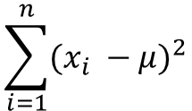
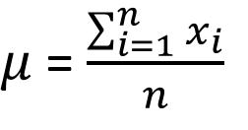
Why is mean so mean?
Find a point that is a representation of all points
$$x=\left[5, 3, 9, 7, 9, 1, 8\right]$$
$μ$= $\frac{\sum_{i=1}^{n}{x_{i}}}{n}$
= 6
More technically find a point that is closest to all other points
3
9
5
1
Could it be?
8
7
9
$$\sum_{i=1}^{n}{{(x_{i} −μ)}^{2}}$$
Derivation?
What is data?
What is parameter?
Is there a hyper-parameter?

Slide 12


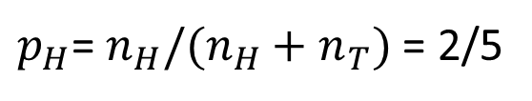
Back to school…
$$data=\left[H, H, T, T, T…\right]$$
What is the likelihood of seeing a head in the next coin toss?
$p_{H}$= $n_{H}/(n_{H}+n_{T})$ = 2/5
More technically, given the data, what is the maximum likelihood of seeing a head?
What is the objective function?

Slide 13
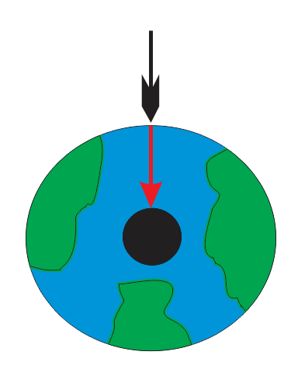
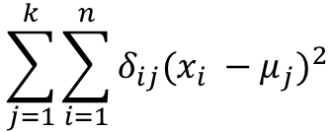
Origin
Find failures that are exemplar of the sample?
K-Means
What is the objective function?
$$\sum_{j=1}^{k}{\sum_{i=1}^{n}{δ_{ij}{(x_{i} −μ_{j})}^{2}}}$$
What is data?
What is parameter?
Is there a hyper-parameter?

Slide 14
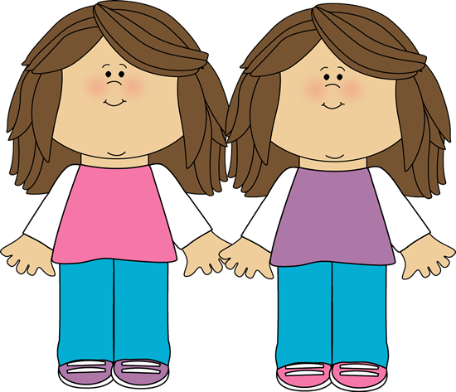

Similarity & Distance
Remember we already used one form of measuring the distance?
$${(x_{i} −μ_{j})}^{2}$$
Let’s explore a few more…

Slide 15

Distance & Similarity with Text
1
2
3
Hello World
Hello World
Hello John
Hello World
Hello
2
Hello World
3
1
John
Hello World
World
1
2
[Hello:1, World:1]
[Hello:4, World:4]
[Hello:1, John:1]
3
[Hello:1, World:1, John:0]
[Hello:4, World:4, John:0]
[Hello:1, World:0, John:1]
4
2
Remember Tfidf?
Hello
1
Remember BoW?
1
1
World
4

Slide 16




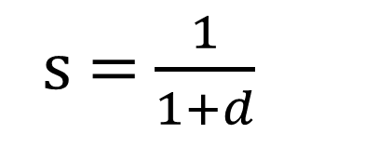

Relationship
Similarity
Distance
Similarity
Distance
=
0
!=
Up-to $∞$
$$∞$$
s = $\frac{1}{1+d}$
distance
1
similarity

Slide 17
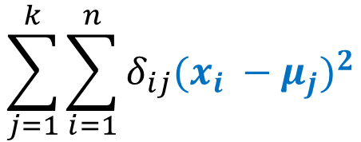
Origin
Find failures that are exemplar of the sample?
K-Means
What is the distance?
$$\sum_{j=1}^{k}{\sum_{i=1}^{n}{δ_{ij}{(x_{i} −μ_{j})}^{2}}}$$

Slide 18


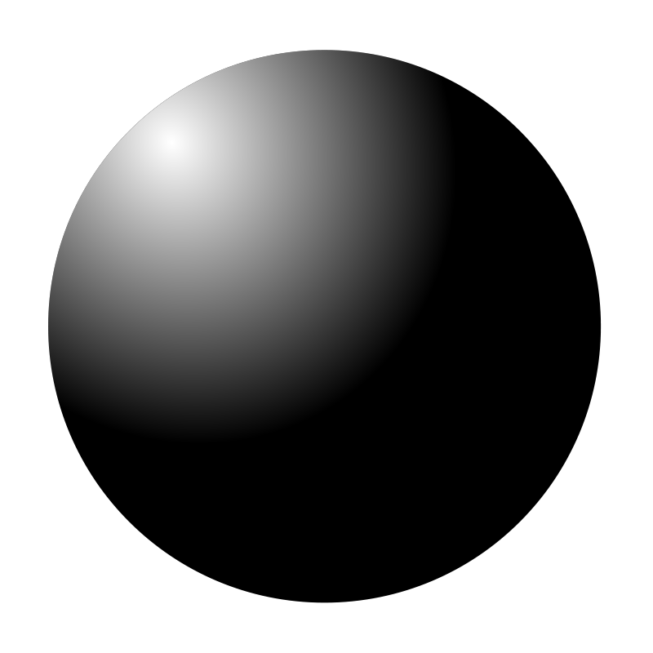



Data Observation
Just viewing data can reveal a lot of insights, the challenge is my eyes cannot visualize high (>3) dimensional data

Slide 19
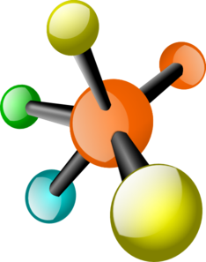


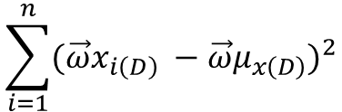

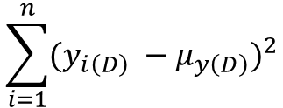



Descriptive
3589
3580
Find the projection that maximizes the variance
Objective Function
$$\sum_{i=1}^{n}{{(y_{i\left(D\right)} −μ_{y\left(D\right)})}^{2}}$$
$$\sum_{i=1}^{n}{{({\vec{ω}x}_{i\left(D\right)} −{\vec{ω}μ}_{x\left(D\right)})}^{2}}$$
$$μ_{x(D)}$$
$$\vec{ω}$$
Remember PCA?
$$μ_{y(D)}$$
$$x_{(D)}$$
What is data?
What is parameter?
$$\vec{ω}$$
$$y_{(D)}$$

Slide 20






Discriminative
3589
0009
Find the projection that maximizes the difference
Objective Function
$${\left(μ_{x\left(D\right)} −μ_{y\left(D\right)}\right)}^{2}/(σ_{x}^{2}+σ_{y}^{2})$$
$$μ_{x(D)}$$
$$μ_{y(D)}$$
$$\vec{ω}$$
Remember FDA?
$$\vec{ω}$$
What is data?
What is parameter?

Slide 21
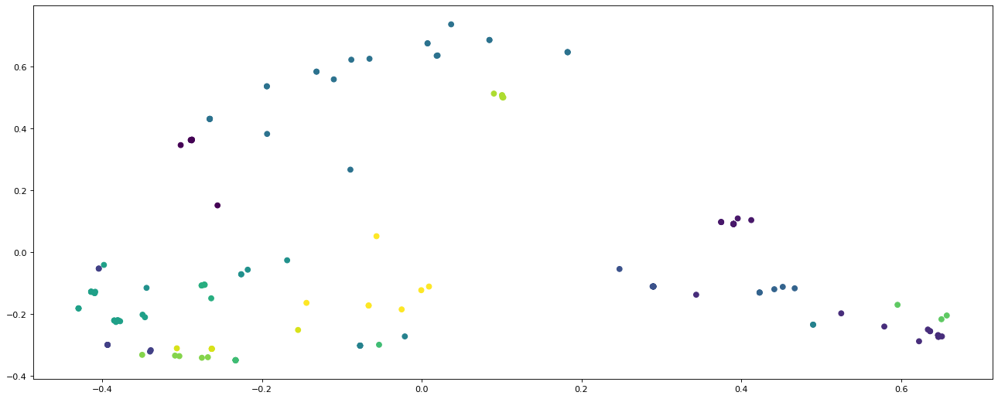
Origin

Slide 22
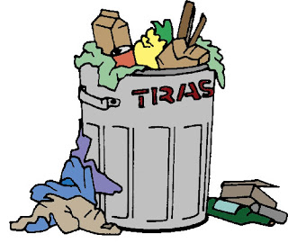
Fine Tuning
Data
Outcome
Traditional
Rules
Data
Rules
ML
Outcome
Garbage
Garbage
Universal
Outcome

Slide 23
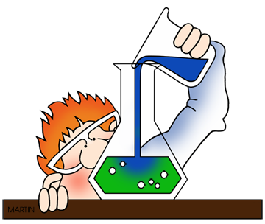
Hyper parameter tuning
What is the right number of clusters in the data?
Find the optimal number of clusters such that the error is minimum
Find the optimal number of clusters such that the inter-cluster variation is minimum and inter cluster variation is maximum

Slide 24



Origin
K, the number of centroids in K-Means is a hyper parameter
Objective Function :- Silhouette score
$$a\left(i\right)= \frac{1}{n−1}\sum_{C_{i}}{d(i,j)}$$
a(i)
b(i)
$$b\left(i\right)= \min{(k!=i})\frac{1}{n−1}\sum_{C_{k}}{d(i,j)}$$
b(i)
$$s\left(i\right)= \frac{b\left(i\right)−a(i)}{max⁡\{a\left(i\right), b\left(i\right)\}}, if |C_{i}>1$$

Slide 25
Non-Spherical Clusters

Slide 26
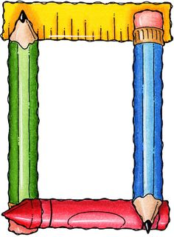
Self Learning Framework
https://github.com/jovinod/applied_machine_learning/blob/master/model_exploration/ModelExploration.md

Slide 27

Q & A

